Slide 1
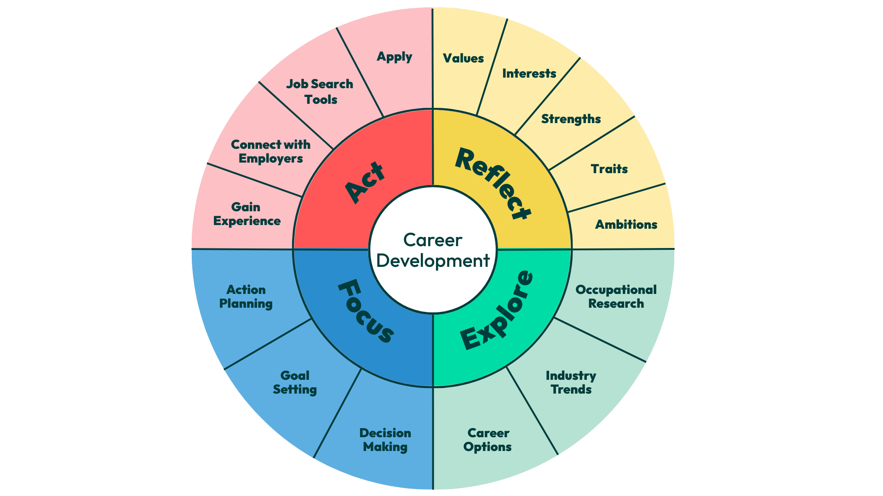
Career Planning
The earlier you start,
the easier it becomes!
Notes:
Gives students an INTRODUCTION to sustainability consulting
Internships are currently 35 hours long, but employers can extend the student contract if they wish to

Slide 2

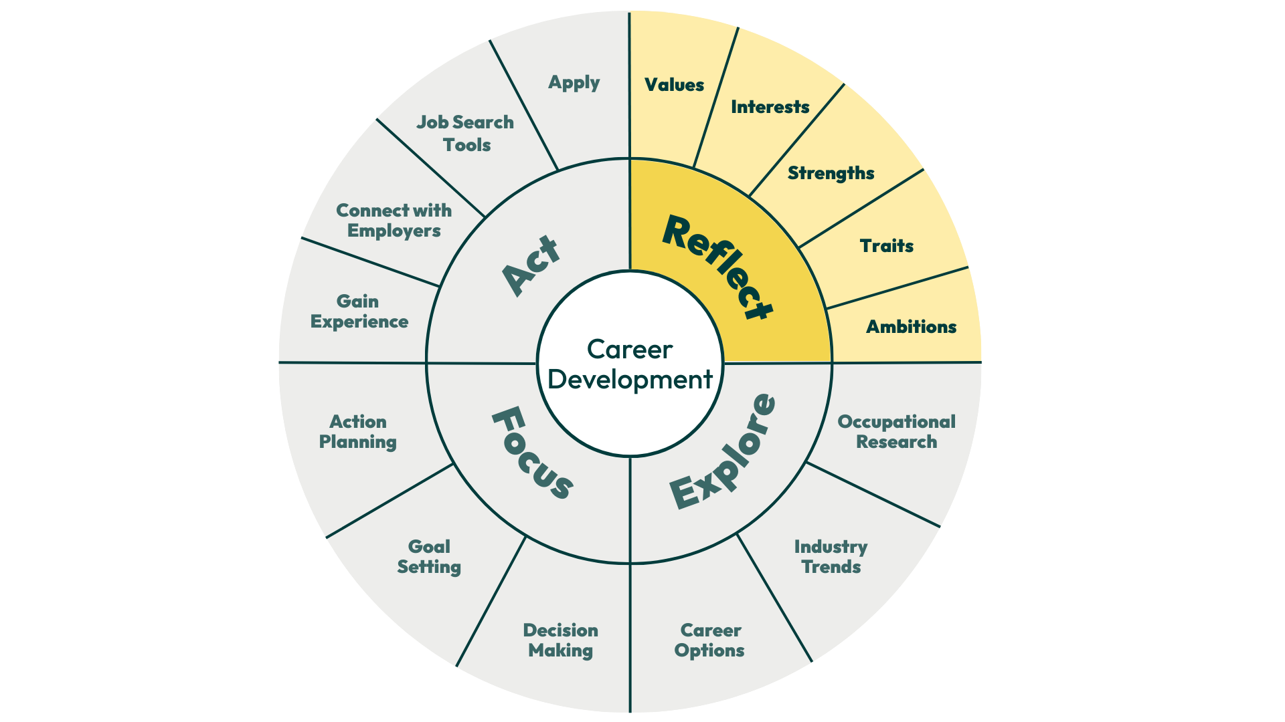
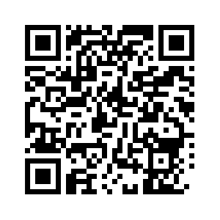
Reflect: Values, strengths, traits, ambitions and skills.
Knowing who you are by reflecting on your skills, interests, values and motivations is an important first step in careers development, but it is often overlooked.
Understanding what really matters to you can help you find your ideal career as you’ll be able to determine if a specific role or employer aligns with your preferences.
Attend ‘Create Your Future’.
Develop your skills.
Attend ‘Your Options Your Future’.

Slide 3
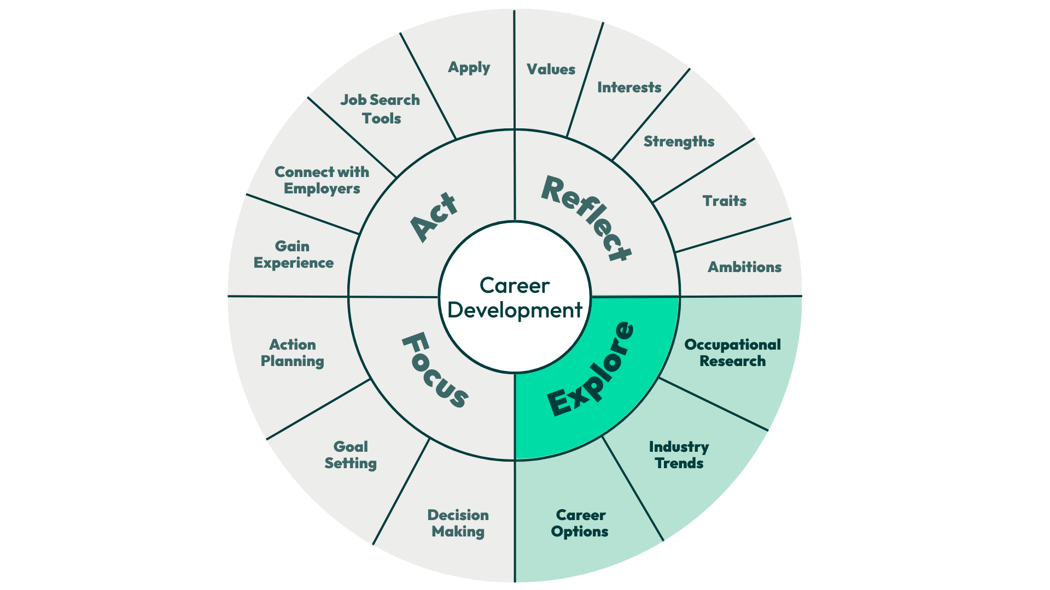
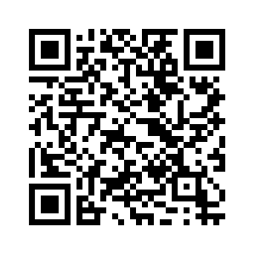
Explore: Occupational research, industry trends, career options.
Exploring your options involves expanding your knowledge of the range of occupations, sectors and organisations that may be of interest to you.
Look at our sector pages, attend careers fairs and develop your network.
You need to think about what it would be like to work in a range of roles in a variety of organisations and what you need to do to gain employment.
Do you need specific training, qualifications or
skills for your desired role?
This takes a lot of research.

Slide 4
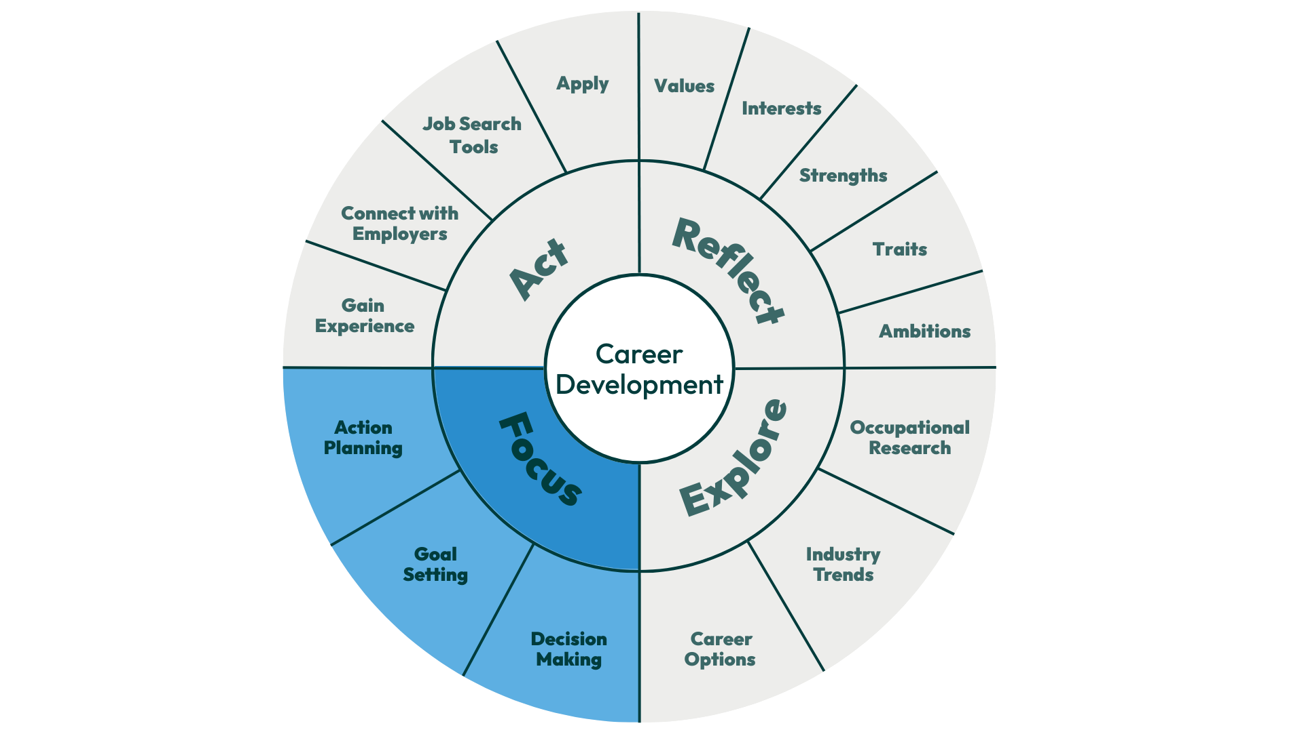
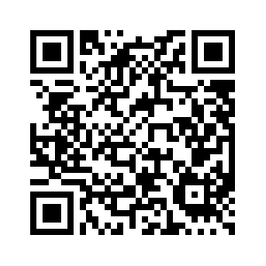
Focus: Decision making, goal setting, action planning and work experience
Once you have done your research, you’ll need to start making informed and realistic decisions to narrow down your options.
This may involve exploring several options, so you will need to be flexible and adaptable in your approach.
Gaining relevant work experience, attending employer events and careers fairs to talk to specific employers will help you in this process.
The groundwork of self- awareness will be critical in keeping you
motivated and helping you to set your goals.

Slide 5
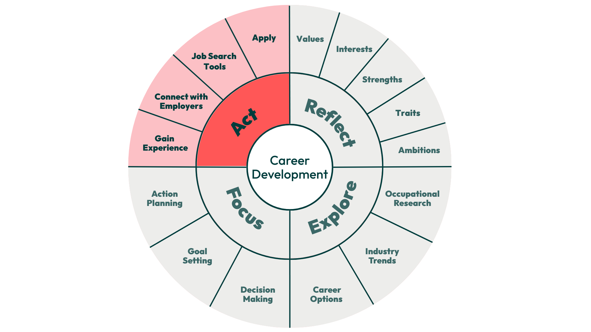
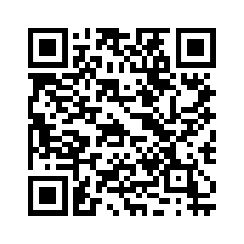
Act: Gaining experience, connecting with employers, job search and applications.
How do you get from where you are now to where you want to be?
What is the recruitment process for the careers that interests you?
What action do you need to take to enable you to move smoothly into your career of choice?

Slide 6





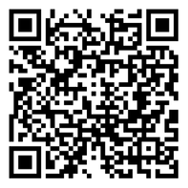

Creating Career Confidence
Unsure about your next steps after university?
University life can feel overwhelming, especially when thinking about the future. If you’re neurodivergent, have a mental health or longer-term health condition, physical disability, or specific learning difficulties eg. dyslexia, dyspraxia, this can be magnified even more.
Running online each term, Creating Career Confidence will help you:
  Gain more confidence and increase resilience in approaching career decisions, including disclosing a disability.
  Discover your strengths, skills and values.
  Explore how to find supportive employers and opportunities.
  Gain an insight into recruitment processes and support available through reasonable adjustments.
Open to all students.
And it counts towards the Exeter Award!
Find out more and sign up.

Slide 7


Career Zone: Getting started
Subscribe to the Career Zone Podcast
Follow socials Instagram, LinkedIn, TikTok - for regular updates
Activate your Handshake account to sign up to events and find jobs.
Read emails and newsletters from Career Zone.
Go to your timetabled Create Your Future Session.
Come to Careers Fairs to talk to employers.

Slide 8



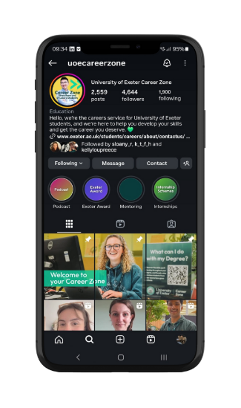
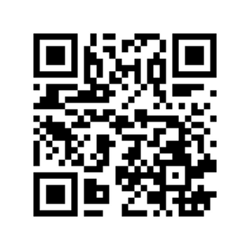
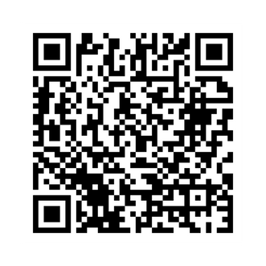
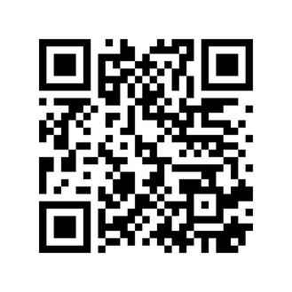

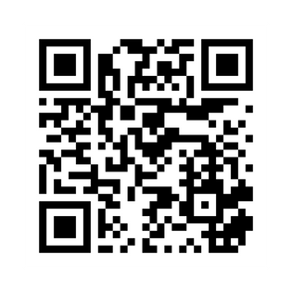
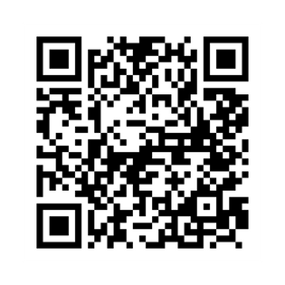
Keep up to date with all the latest opportunities
TikTok
LinkedIn
Career Zone Podcast
Instagram
Streatham
Instagram
Penryn

