Slide 1
FOOD WASTE
CAN YOU CHANGE THE WORLD?

Slide 2
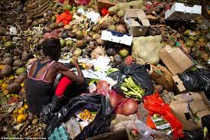
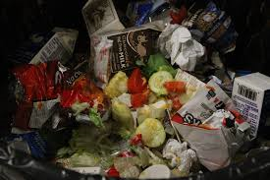
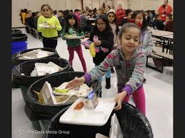
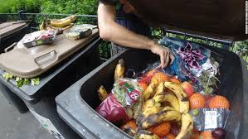

Slide 3
Video clip 1:
https://www.youtube.com/watch?v=tU1m6EWMZaY

Slide 4
Statement Sentences
We live in a society where food seems to be everywhere.
One in four apples in fridges and fruit-bowls is thrown away.
The amount of food wasted in UK homes each year is 7.2 million tonnes.

Slide 5
Being Persuasive
These are all sentences from different reports on food waste. The writers have thought about how to be persuasive – thinking about what they write and how they express it.
With food bank visits at an all-time high, the amount supermarkets are throwing away is appalling.
A survey reveals a staggering two thirds of some freshly bought food goes to waste.
The average UK family is wasting nearly £60 a month by throwing away almost an entire meal a day.
One third of all food produced in the world ends up as waste.

Slide 6
Being Persuasive
These are all sentences from different reports on food waste. The writers have thought about how to be persuasive – thinking about what they write and how they express it.
With food bank visits at an all-time high, the amount supermarkets are throwing away is appalling.
A survey reveals a staggering two thirds of some freshly bought food goes to waste.
The average UK family is wasting nearly £60 a month by throwing away almost an entire meal a day.
One third of all food produced in the world ends up as waste.
The sentences are all clear statements which express the writer’s point of view.

Slide 7
Being Persuasive
They use vocabulary which emphasises the point of view.
These are all sentences from different reports on food waste. The writers have thought about how to be persuasive – thinking about what they write and how they express it.
With food bank visits at an all-time high, the amount supermarkets are throwing away is appalling.
A survey reveals a staggering two thirds of some freshly bought food goes to waste.
The average UK family is wasting nearly £60 a month by throwing away almost an entire meal a day.
One third of all food produced in the world ends up as waste.
The sentences are all clear statements which express the writer’s point of view

Slide 8
Being Persuasive
They use vocabulary which emphasises the point of view.
These are all sentences from different reports on food waste. The writers have thought about how to be persuasive – thinking about what they write and how they express it.
With food bank visits at an all-time high, the amount supermarkets are throwing away is appalling.
A survey reveals a staggering two thirds of some freshly bought food goes to waste.
The average UK family is wasting nearly £60 a month by throwing away almost an entire meal a day.
One third of all food produced in the world ends up as waste.
They choose facts which support their point of view.
The sentences are all clear statements which express the writer’s point of view

Slide 9
Being Persuasive
You can sometimes make your point stronger by stating it using a short single clause sentence:
With food bank visits at an all-time high, the amount supermarkets are throwing away is appalling.
The amount of food waste from supermarkets is appalling.
The average UK family is wasting nearly £60 a month by throwing away almost an entire meal a day.
The average UK family throws away almost an entire meal a day.
One third of all food produced in the world ends up as waste.
One third of the world’s food ends up as waste.

Slide 10
Being a Persuasive Writer
There are many choices you can make as a writer to make your writing more persuasive and express your point of view strongly. We have been looking at:
  Making vocabulary choices which signal your point of view:
  eg appalling; staggering; waste;
  Using clear statement sentences to make important points:
  A survey reveals a staggering two thirds of some freshly bought food goes to waste.
  Choosing information which supports your point of view:
  One third of all food produced in the world ends up as waste.
  Using short single clause sentences to draw attention to your point:
  The amount of food waste from supermarkets is appalling.
  You can make choices as a writer which could persuade people to take action to change the world!

Slide 11
Words to Change the World
Nouns:
rubbish wastefulness disposal refuse environment
consumer consumption perishables landfill produce suppliers exporters packaging emissions pollution resources
Verbs
squander misuse redistribute pollute
Adjectives:
nourishing unsold edible consumable mis-shapen imperfect

Slide 12
PERSUADING WITH MODAL VERBS

Slide 13
Modal Verbs
can could will would shall should may might must ought to
You can have chocolate after dinner;
You must have chocolate after dinner;
You should have chocolate after dinner;
You could have chocolate after dinner.

Slide 14


Modal Verbs
must can will may would shall should could might ought to
loud
You can have chocolate after dinner.
Turning up the volume: modal verbs can be used for gentle persuasion or strong persuasion, like turning up or turning down the volume on the television
soft

Slide 15


Modal Verbs
can could will would shall should may might must ought to
they simply cannot make ends meet
more could be done to reduce food waste
Just imagine what it must be like …
supermarkets should also be encouraged to offer a service …
Delivery vans could then drop much needed perishables to people on the delivery route …
My health would have improved immeasurably …
I would have been spared…
France has already proven that this can work

Slide 16
Reflection Point
What do you know about food waste now?
What facts do you know that might support an argument?
What are the different ways in which food gets wasted?
What are the consequences of food waste?
Why does it matter?

Slide 17
Video clip 2:
https://www.youtube.com/watch?v=ZVkaYxJDqmI

Slide 18
Planning and Drafting
What strategies do you use when you have to plan a piece of writing?
What strategies do you use when you are drafting a piece of text?

Slide 19
Planning and Drafting
What strategies do you use when you have to plan a piece of writing?
making sure you know enough about the topic you have to write about
thinking about the vocabulary you might need
making sure you know what kind of writing you have to do
gathering ideas for what to write about
What strategies do you use when you are drafting a piece of text?
pausing occasionally to re-read the text
thinking ahead to where the text will end
remembering what kind of writing you have to do
thinking about your reader and how you want them to think or feel

Slide 20
Writing Task
What is the opinion you want to express?
Who is the audience?
Write a letter to your local paper arguing that so much food waste is wrong and suggesting what action we should take to reduce food waste. [No more than 300 words]
What is the purpose of this task? What do you want to happen if someone reads your letter?
How do you need to write this letter to be persuasive?
What do you know about how to write letters?

Slide 21
Writing Together
One pen: three heads!
Collaborative writing is about using everyone in the group to compose a single piece of writing.
You will need to:
listen to each other’s suggestions
try out different possibilities for your writing
make suggestions yourself
discuss disagreements politely and thoughtfully (they are often the most interesting points!)

Slide 22
Being a Persuasive Writer
There are many choices you can make as a writer to make your writing more persuasive and express your point of view strongly. We have been looking at:
  Using clear statement sentences to make important points
  Using single clause sentences to draw attention to key points
  Choosing positioning vocabulary to indicate your point of view
  Choosing information, such as statistics, to support your point of view
  Using modal verbs to indicate different levels of assertion/possibility

Slide 23
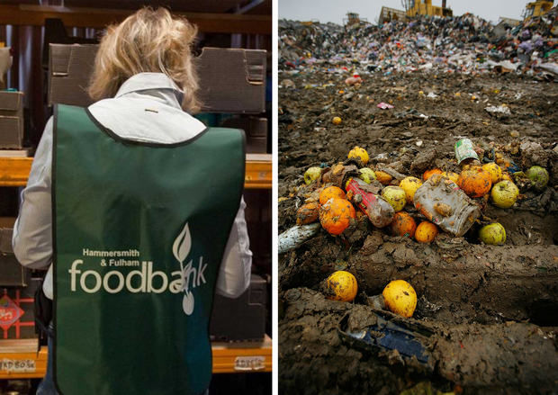

Slide 24
PERSUASIVE ADVERBS

Slide 25
Adverbs to show Point of View
I'm passionate about making this happen because a few years ago I fell on hard luck myself. I lost my job through no fault of my own due to a chronic illness. My health would have improved immeasurably had I been able to afford fresh, healthy, fruit and vegetables.
If a scheme whereby these life-giving items were available to me for free had been provided back then, I would have been spared the constant choice of eating properly or paying the ever-mounting bills. I was incredibly lucky that I had friends and family to bail me out and buy me a few groceries during the bleakest of times, but so many others are just not as fortunate.
Now that I am well enough to support myself again, I don't want anyone else to experience the hell I went through. The food is THERE and it’s perfectly good and nourishing. There are so many people who need it right now, despite what the government might try to make you believe.
So what are we waiting for? France has already proven that this can work. So I’m asking for Parliament to take this campaign seriously and rush through a change in the law as soon as possible, before anyone else in the UK starves needlessly.

Slide 26
Adverbials to connect Ideas
After reading about the bill being passed in France to force supermarkets to give their unsold but still consumable food products to at least one food charity I decided that I’d try to do something for us here in the UK. For, while we may be separated by the Channel, our problems with waste are very much the same. For example, two years ago Tesco announced that it had generated almost 30,000 tonnes of food waste over just six months.
In light of the successful French campaign to cut waste, I started a petition in the UK hoping that it may eventually make it to a debate in Parliament. I needed to get 100,000 signatures for this to happen. It's now got over 150,000, and has been popping up all over the world, across the press and social media.
There are two main threads to my campaign. First of all, I believe that supermarkets should be legally obliged to hand over all unsold but still edible foods to various food distribution charities instead of it going straight to landfill. On top of this, supermarkets should also be encouraged to offer a service whereby customers can opt in for voluntary weekly donations (a small sum, around £2) when they buy their groceries online.

Slide 27
Adverbials to connect Ideas
There are two main threads to my campaign. First of all, I believe that supermarkets should be legally obliged to hand over all unsold but still edible foods to various food distribution charities instead of it going straight to landfill. On top of this, supermarkets should also be encouraged to offer a service whereby customers can opt in for voluntary weekly donations (a small sum, around £2) when they buy their groceries online.
In this paragraph the two adverbial phrases, ‘First of all’ and ‘On top of this’, link back to the opening sentence and the ‘two main threads’. Thread 1 is introduced by ‘First of all’ and thread 2 by ‘On top of this’. This helps to make the paragraph coherent and flow well.
Have you noticed that this writer uses a short single clause sentence to introduce this paragraph?

Slide 28
Adverbials to Connect Ideas
Some examples of other adverbial phrases which can connect ideas across sentences and across your writing:
  on the other hand
  despite this
  even so
  to sum up
  in contrast
  as a result
  for instance
  You might know some more?

Slide 29
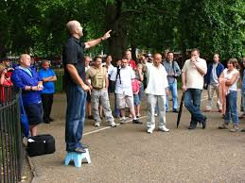
Have your Say!
Your chance to change the world!
Make an argument expressing your opinion about food waste.

Slide 30
Revising Well
Revising what you have written: the content:-
How strong are the points you have made?
How much detail or information have you given to support your argument?
Revising how you have written it: the choices you have made:-
How have you made your text persuasive?
What language choices can you make to create a really persuasive text?
Revising strategies:
Reading and re-reading; crossing out words and phrases; writing new words or phrases in margins; using arrows to show where things need to move around; reading aloud to each other; trying out different choices …
Revising is messy!

Slide 31
Recap
Positioning vocabulary to indicate the writer’s point of view
There are two main threads to my campaign. First of all, I believe that supermarkets should be legally obliged to hand over all unsold but still edible foods to various food distribution charities instead of it going straight to landfill. On top of this, supermarkets should also be encouraged to offer a service whereby customers can opt in for voluntary weekly donations (a small sum, around £2) when they buy their groceries online. Delivery vans could then drop much needed perishables to people on the delivery route who are housebound.

Slide 32
Recap
Using positioning vocabulary to indicate your point of view
Using clear statement sentences to make important points
  Using single clause sentences to draw attention to key points
There are two main threads to my campaign. First of all, I believe that supermarkets should be legally obliged to hand over all unsold but still edible foods to various food distribution charities instead of it going straight to landfill. On top of this, supermarkets should also be encouraged to offer a service whereby customers can opt in for voluntary weekly donations (a small sum, around £2) when they buy their groceries online. Delivery vans could then drop much needed perishables to people on the delivery route who are housebound.

Slide 33
Recap
Using connecting adverbials to link ideas across sentences
There are two main threads to my campaign. First of all, I believe that supermarkets should be legally obliged to hand over all unsold but still edible foods to various food distribution charities instead of it going straight to landfill. On top of this, supermarkets should also be encouraged to offer a service whereby customers can opt in for voluntary weekly donations (a small sum, around £2) when they buy their groceries online. Delivery vans could then drop much needed perishables to people on the delivery route who are housebound.

Slide 34
Recap
Using modal verbs to indicate different levels of assertion/possibility
There are two main threads to my campaign. First of all, I believe that supermarkets should be legally obliged to hand over all unsold but still edible foods to various food distribution charities instead of it going straight to landfill. On top of this, supermarkets should also be encouraged to offer a service whereby customers can opt in for voluntary weekly donations (a small sum, around £2) when they buy their groceries online. Delivery vans could then drop much needed perishables to people on the delivery route who are housebound.

Slide 35
Recap
Choosing adverbs which reveal your viewpoint
So what are we waiting for? France has already proven that this can work. So I’m asking for Parliament to take this campaign seriously and rush through a change in the law as soon as possible, before anyone else in the UK starves needlessly.

Slide 36
Recap
  Choosing information, such as statistics, to support your point of view
France has already proven that this can work.
The average UK family is wasting nearly £60 a month by throwing away almost an entire meal a day.
One third of all food produced in the world ends up as waste.

Slide 37
Being a Persuasive Writer
There are many choices you can make as a writer to make your writing more persuasive and express your point of view strongly. We have been looking at:
  Using clear statement sentences to make important points
  Using single clause sentences to draw attention to key points
  Choosing positioning vocabulary to indicate your point of view
  Choosing information, such as statistics, to support your point of view
  Using modal verbs to indicate different levels of assertion/possibility
  Choosing adverbs to reveal or emphasise your point of view
  Choosing connecting adverbials to link ideas across sentences
As you revise your writing, think about the best choices you can make to create a really persuasive text.

Slide 38
Writing Task
What is the opinion you want to express?
Who is the audience?
Write a letter to your local paper arguing that so much food waste is wrong and suggesting what action we should take to reduce food waste. [No more than 300 words]
What do you want to happen if someone reads your letter?
How do you need to write this letter to be persuasive?
What do you know about how to write letters?
Write your own persuasive letter, thinking carefully about the choices you make. Make this a letter that could change the world!

