Slide 1
Writing to Change the World!
Save the Tiger!

Slide 2
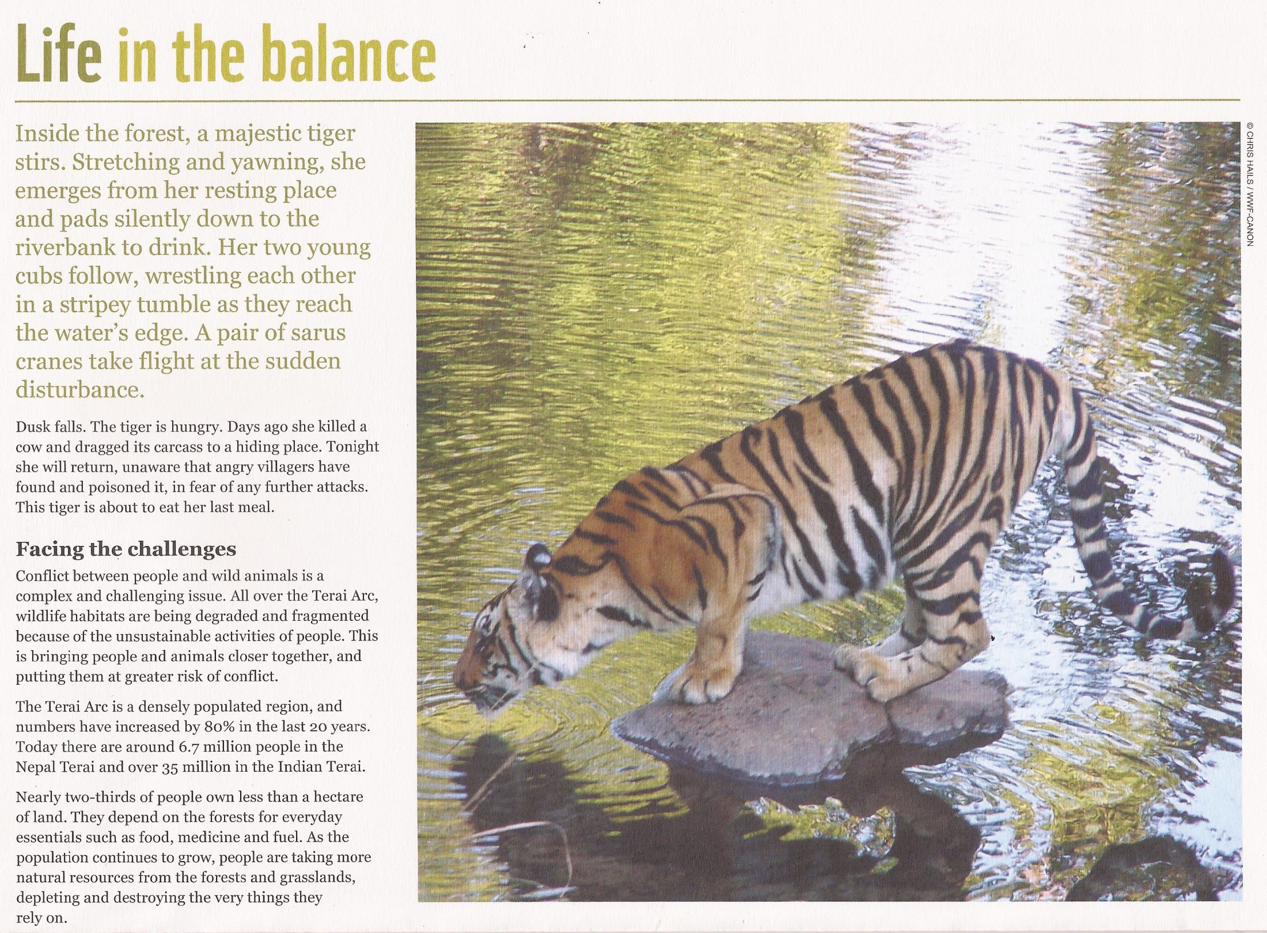

Slide 3
Inside the forest, a majestic tiger stirs. Stretching and yawning, she emerges from her resting place and pads silently down to the riverbank to drink. Her two young cubs follow, wrestling each other in a stripey tumble as they reach the water’s edge. A pair of sarus cranes take flight at the sudden disturbance.

Slide 4
Inside the forest, a majestic tiger stirs. Stretching and yawning, she emerges from her resting place and pads silently down to the riverbank to drink. Her two young cubs follow, wrestling each other in a stripey tumble as they reach the water’s edge. A pair of sarus cranes take flight at the sudden disturbance.

Slide 5
Inside the forest, a majestic tiger stirs. Stretching and yawning, she emerges from her resting place and pads silently down to the riverbank to drink. Her two young cubs follow, wrestling each other in a stripey tumble as they reach the water’s edge. A pair of sarus cranes take flight at the sudden disturbance.

Slide 6
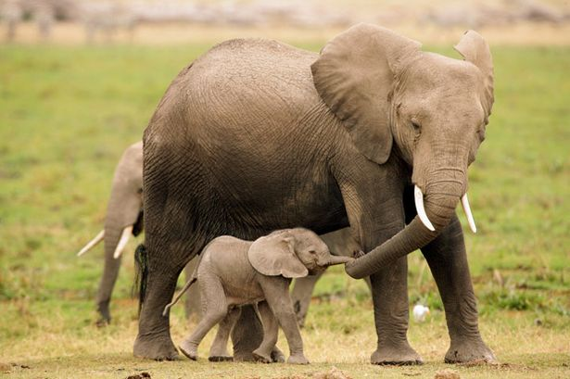

Slide 7
A very short sentence.
Why might the author be drawing attention to the fact that night is coming?
Another short sentence.
What information does it draw attention to?
Dusk falls. The tiger is hungry. Days ago, she killed a cow and dragged its carcass to a hiding place. Tonight she will return, unaware that angry villagers have found and poisoned it, in fear of any further attacks. The tiger is about to eat her last meal.
Another short sentence.
How does the writer want to make us feel?
Two longer sentences explain to us what has happened.

